Slide 1
Programming
Preparation

Slide 2
Java script
Fundamentals
Advanced

Slide 3
intro
JavaScript is the world's most popular programming language.
JavaScript is the programming language of the Web.
JavaScript is easy to learn.
JavaScript is one of the 3 languages all web developers must learn:
HTML to define the content of web pages
CSS to specify the layout of web pages
JavaScript to program the behavior of web pages

Slide 4
Data types and variables
The concept of data types
Examples
In programming, data types is an important concept.
To be able to operate on variables, it is important to know something about the type.
Without data types, a computer cannot safely solve this …
let x = 16 + "Volvo";
When adding a number and a string, JavaScript will treat the number as a string.
let x = 16 + "Volvo";
JavaScript evaluates expressions from left to right. Different sequences can produce different results:

Slide 5
Data types and variables
let x = 16 + 4 + "Volvo";
//20Volvo
let x = "Volvo" + 16 + 4;
//Volvo164
JavaScript has dynamic types. This means that the same variable can be used to hold different data types:
let x; // Now x is undefined x = 5; // Now x is a Number x = "John"; // Now x is a String

Slide 6
JavaScript Strings
A string (or a text string) is a series of characters like "John Doe".
Strings are written with quotes. You can use single or double quotes:
let carName1 = "Volvo XC60"; // Using double quotes let carName2 = 'Volvo XC60'; // Using single quotes
You can use quotes inside a string, as long as they don't match the quotes surrounding the string:
let answer1 = "It's alright"; // Single quote inside let answer2 = "He is called 'Johnny'"; // Single quotes let answer3 = 'He is called "Johnny"'; // Double quotes

Slide 7

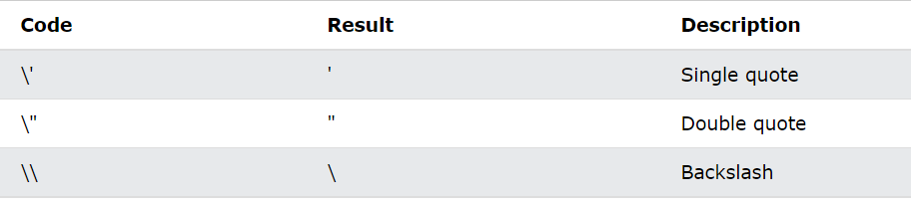
Length and escape character
To find the length of a string, use the built-in length property:
Because strings must be written within quotes, JavaScript will misunderstand this string:

Slide 8

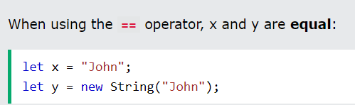
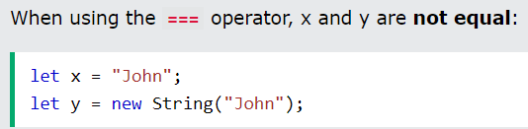
JavaScript Strings as Objects
Normally, JavaScript strings are primitive values, created from literals:
But strings can also be defined as objects with the keyword new:
Do not create Strings objects.
The new keyword complicates the code and slows down execution speed.
String objects can produce unexpected results:
Comparing two JavaScript objects always returns false.

Slide 9
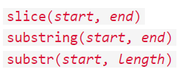


JavaScript extracting string parts
There are 3 methods for extracting a part of a string:
slice() extracts a part of a string and returns the extracted part in a new string.The method takes 2 parameters: the start position, and the end position (end not included).
If a parameter is negative, the position is counted from the end of the string. Str.length = 19, 19 – 12 = 7; 19 – 6 = 13

Slide 10



Extracting 2
If you omit the second parameter, the method will slice out the rest of the string:
substring() is similar to slice().
The difference is that start and end values less than 0 are treated as 0 in substring().
substr() is similar to slice().
The difference is that the second parameter specifies the length of the extracted part.
If the first parameter is negative, the position counts from the end of the string.

Slide 11

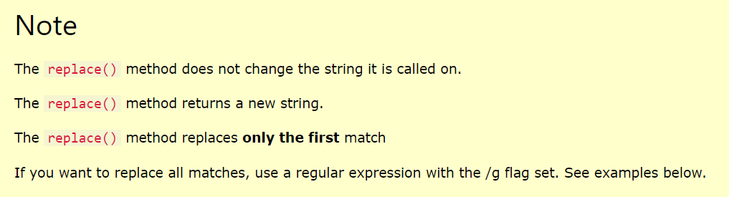
Replacing String Content
The replace() method replaces a specified value with another value in a string:
By default, the replace() method is case sensitive. Writing MICROSOFT (with upper-case) will not work, in that case use regular expression:
To replace all matches:

Slide 12


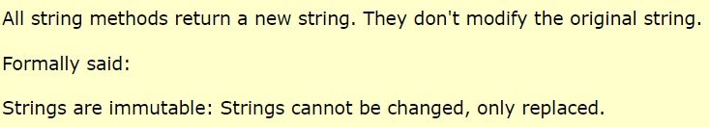
Converting to Upper and Lower Case
A string is converted to upper case with toUpperCase():
A string is converted to lower case with toLowerCase():
The concat() method can be used instead of the plus operator. These two lines do the same:

Slide 13



JavaScript String trim()
The trim() method removes whitespace from both sides of a string:
The trimStart() method works like trim(), but removes whitespace only from the start of a string.
The trimEnd() method works like trim(), but removes whitespace only from the end of a string.

Slide 14




JavaScript String Padding
The padStart() method pads a string with another string:
The padEnd() method pads a string with another string:
To pad a number, convert the number to a string first.

Slide 15




Extracting String Characters
There are 3 methods for extracting string characters:
The charAt() method returns the character at a specified index (position) in a string: //H
The charCodeAt() method returns the unicode of the character at a specified index in a string:
The method returns a UTF-16 code (an integer between 0 and 65535). //72

Slide 16
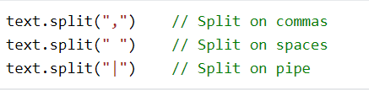


Converting a String to an Array
A string can be converted to an array with the split() method:
If the separator is omitted, the returned array will contain the whole string in index [0].
If the separator is "", the returned array will be an array of single characters:

Slide 17
JavaScript Numbers
JavaScript has only one type of numbers.
Numbers can be written with, or without decimals:
let x1 = 34.00; // Written with decimals let x2 = 34; // Written without decimals
Extra large or extra small numbers can be written with scientific (exponential) notation:
let y = 123e5; // 12300000 let z = 123e-5; // 0.00123

Slide 18
JavaScript Booleans
Booleans can only have two values: true or false.
let x = 5; let y = 5; let z = 6; (x == y) // Returns true (x == z) // Returns false
Booleans are often used in conditional testing.

Slide 19
JavaScript Arrays
JavaScript arrays are written with square brackets.
Array items are separated by commas.
The following code declares (creates) an array called cars, containing three items (car names):
const cars = ["Saab", "Volvo", "BMW"];
Array indexes are zero-based, which means the first item is [0], second is [1], and so on.

Slide 20
JavaScript Objects
JavaScript objects are written with curly braces {}.
Object properties are written as name:value pairs, separated by commas.
const person = {firstName:"John", lastName:"Doe", age:50, eyeColor:"blue"};
The object (person) in the example above has 4 properties: firstName, lastName, age, and eyeColor.

Slide 21
The typeof Operator
You can use the JavaScript typeof operator to find the type of a JavaScript variable.
The typeof operator returns the type of a variable or an expression:
typeof "" // Returns "string" typeof "John" // Returns "string" typeof "John Doe" // Returns "string“
typeof 0 // Returns "number" typeof 314 // Returns "number" typeof 3.14 // Returns "number" typeof (3) // Returns "number" typeof (3 + 4) // Returns "number"

Slide 22
Undefined
In JavaScript, a variable without a value, has the value undefined. The type is also undefined.
let car; // Value is undefined, type is undefined
Any variable can be emptied, by setting the value to undefined. The type will also be undefined.
car = undefined; // Value is undefined, type is undefined

Slide 23
Empty Values
An empty value has nothing to do with undefined.
An empty string has both a legal value and a type.
let car = ""; // The value is "", the typeof is "string"

Slide 24
includes
The includes() method determines whether an array/string includes a certain value among its entries, returning true or false as appropriate.
const array1 = [1, 2, 3];
console.log(array1.includes(2));
// expected output: true
const pets = ['cat', 'dog', 'bat'];
console.log(pets.includes('cat'));
// expected output: true
console.log(pets.includes('at'));
// expected output: false

Slide 25
Math.trunc
The Math.trunc() function returns the integer part of a number by removing any fractional digits.
console.log(Math.trunc(13.37)); // expected output:13
console.log(Math.trunc(42.84)); // expected output: 42
console.log(Math.trunc(0.123)); // expected output: 0
console.log(Math.trunc(-0.123)); // expected output: -0

Slide 26
Ascii table values
From String to Ascii value
From Ascii value to string
let character = ‘L’;
let asciiValue = character.CharCodeAt(0);
Console.log(asciiValue);
//72
let asciiValue = 97;
let str = String.FromCharCode(asciiValue);
Console.log(str);
//’a’

Slide 27
JavaScript Functions
function myFunction(p1, p2) { return p1 * p2;
// The function returns the product of p1 and p2 }
myFunction(1, 2);
// 2
A JavaScript function is a block of code designed to perform a particular task.
A JavaScript function is executed when "something" invokes it (calls it).

Slide 28
JavaScript Function Syntax
A JavaScript function is defined with the function keyword, followed by a name, followed by parentheses ().
Function names can contain letters, digits, underscores, and dollar signs (same rules as variables).
The parentheses may include parameter names separated by commas: (parameter1, parameter2, ...)
The code to be executed, by the function, is placed inside curly brackets: {}
function name(parameter1, parameter2, parameter3) { // code to be executed }

Slide 29
Function invocation and return
The code inside the function will execute when "something" invokes (calls) the function:
When an event occurs (when a user clicks a button)
When it is invoked (called) from JavaScript code
Automatically (self invoked)
When JavaScript reaches a return statement, the function will stop executing.
If the function was invoked from a statement, JavaScript will "return" to execute the code after the invoking statement.
Functions often compute a return value. The return value is "returned" back to the "caller":

Slide 30
Why functions
let x = myFunction(4, 3);
// Function is called, return value will end up in x function myFunction(a, b) { return a * b;
// Function returns the product of a and b }
You can reuse code: Define the code once, and use it many times.
You can use the same code many times with different arguments, to produce different results.

Slide 31
Local variables
Variables declared within a JavaScript function, become LOCAL to the function.
Local variables can only be accessed from within the function.
// code here can NOT use carName function myFunction() { let carName = "Volvo"; // code here CAN use carName } // code here can NOT use carName
Since local variables are only recognized inside their functions, variables with the same name can be used in different functions.
Local variables are created when a function starts, and deleted when the function is completed.

Slide 32
JS objects and classes

Slide 33
oBJECTS

Slide 34
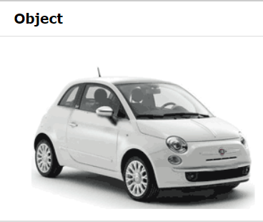
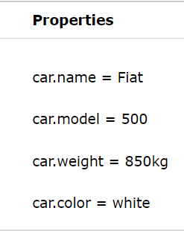
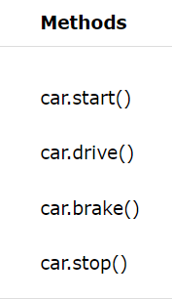
JavaScript Objects
Real Life Objects, Properties, and Methods
In real life, a car is an object.
A car has properties like weight and color, and methods like start and stop:

Slide 35

JavaScript Objects
All cars have the same properties, but the property values differ from car to car.
All cars have the same methods, but the methods are performed at different times.
You have already learned that JavaScript variables are containers for data values.
This code assigns a simple value (Fiat) to a variable named car:
Objects are variables too. But objects can contain many values.
This code assigns many values (Fiat, 500, white) to a variable named car:

Slide 36
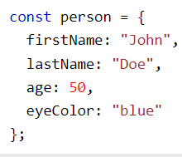
Object definition
The values are written as name:value pairs (name and value separated by a colon).
You define (and create) a JavaScript object with an object literal:
Spaces and line breaks are not important. An object definition can span multiple lines:

Slide 37
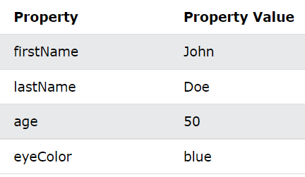






Object Properties
The name:values pairs in JavaScript objects are called properties:
You can access object properties in two ways:

Slide 38
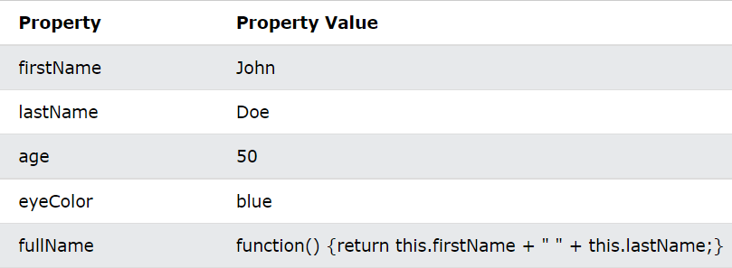

Object Methods
Objects can also have methods.
Methods are actions that can be performed on objects.
Methods are stored in properties as function definitions.

Slide 39
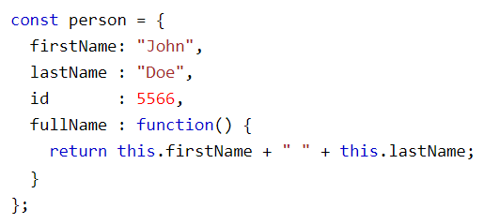
Method example
In the example above, this refers to the person object.
I.E. this.firstName means the firstName property of this.
I.E. this.firstName means the firstName property of person.

Slide 40
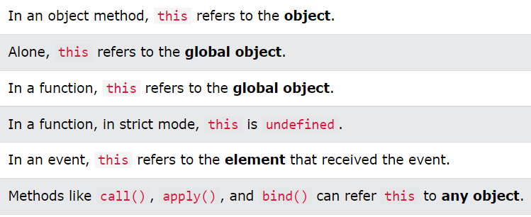
What is this?
In JavaScript, the this keyword refers to an object.
Which object depends on how this is being invoked (used or called).
The this keyword refers to different objects depending on how it is used:

Slide 41



Accessing Object Methods
You access an object method with the following syntax:
If you access a method without the () parentheses, it will return the function definition:

Slide 42

Do Not Declare Strings, Numbers, and Booleans as Objects!
When a JavaScript variable is declared with the keyword "new", the variable is created as an object:
Avoid String, Number, and Boolean objects. They complicate your code and slow down execution speed.

Slide 43
OBJECT DEFINITIONS

Slide 44
JavaScript Objects
In JavaScript, objects are king. If you understand objects, you understand JavaScript.
In JavaScript, almost "everything" is an object.
All JavaScript values, except primitives, are objects.
Booleans can be objects (if defined with the new keyword)
Numbers can be objects (if defined with the new keyword)
Strings can be objects (if defined with the new keyword)
Dates are always objects
Maths are always objects
Regular expressions are always objects
Arrays are always objects
Functions are always objects
Objects are always objects

Slide 45
JavaScript Primitives
A primitive value is a value that has no properties or methods.
3.14 is a primitive value
A primitive data type is data that has a primitive value.
JavaScript defines 7 types of primitive data types:
string
number
boolean
null
undefined
symbol
bigint

Slide 46
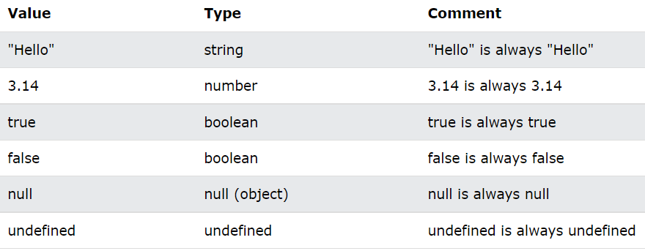
Immutable
Primitive values are immutable (they are hardcoded and cannot be changed).
if x = 3.14, you can change the value of x, but you cannot change the value of 3.14.

Slide 47

Objects are Variables
JavaScript variables can contain single values:
JavaScript variables can also contain many values.
Objects are variables too. But objects can contain many values.
Object values are written as name : value pairs (name and value separated by a colon).
A JavaScript object is a collection of named values
It is a common practice to declare objects with the const keyword.

Slide 48
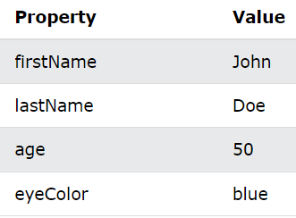
Object Properties
The named values, in JavaScript objects, are called properties.
Objects written as name value pairs are similar to:
Associative arrays in PHP
Dictionaries in Python
Hash tables in C
Hash maps in Java
Hashes in Ruby and Perl

Slide 49
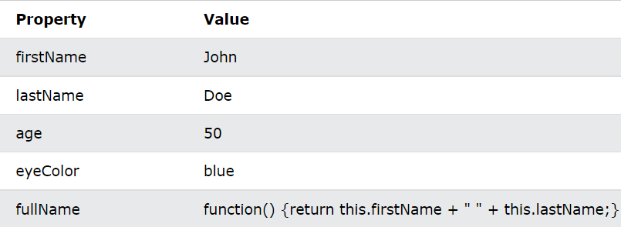
Object Methods
Methods are actions that can be performed on objects.
Object properties can be both primitive values, other objects, and functions.
An object method is an object property containing a function definition.

Slide 50
Creating a JavaScript Object
With JavaScript, you can define and create your own objects.
There are different ways to create new objects:
Create a single object, using an object literal.
Create a single object, with the keyword new.
Define an object constructor, and then create objects of the constructed type.
Create an object using Object.create().

Slide 51
Using an Object Literal
This is the easiest way to create a JavaScript Object.
Using an object literal, you both define and create an object in one statement.
An object literal is a list of name:value pairs (like age:50) inside curly braces {}.
The following example creates a new JavaScript object with four properties:

Slide 52
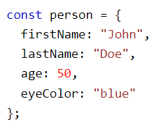
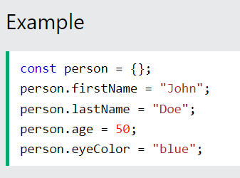
paces and line breaks are not important. An object definition can span multiple lines:
This example creates an empty JavaScript object, and then adds 4 properties:

Slide 53
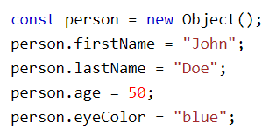
Using the JavaScript Keyword new
The following example create a new JavaScript object using new Object(), and then adds 4 properties:
The examples above do exactly the same.
But there is no need to use new Object().
For readability, simplicity and execution speed, use the object literal method.

Slide 54
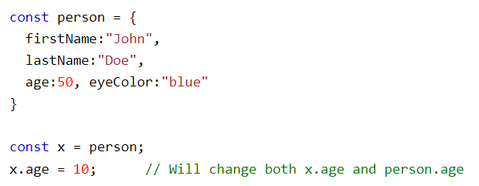
JavaScript Objects are Mutable
Objects are mutable: They are addressed by reference, not by value.
If person is an object, the following statement will not create a copy of person:
The object x is not a copy of person. It is person. Both x and person are the same object.
Any changes to x will also change person, because x and person are the same object.

Slide 55
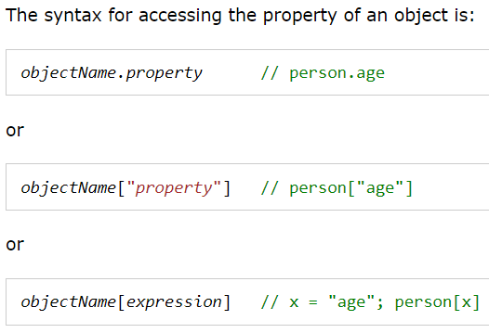
JavaScript Object Properties and access
Properties are the values associated with a JavaScript object.
A JavaScript object is a collection of unordered properties.
Properties can usually be changed, added, and deleted, but some are read only.

Slide 56
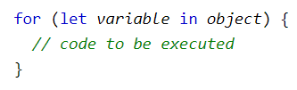
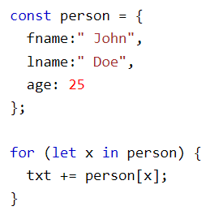

JavaScript for...in Loop
The JavaScript for...in statement loops through the properties of an object.

Slide 57

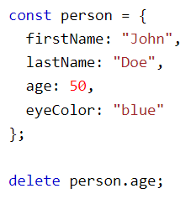
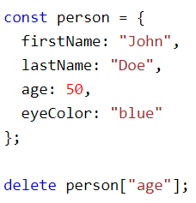
Adding and deleting properties
You can add new properties to an existing object by simply giving it a value.
Assume that the person object already exists - you can then give it new properties:
The delete keyword deletes a property from an object:

Slide 58
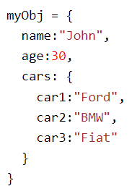




Nested Objects
Values in an object can be another object:
You can access nested objects using the dot notation or the bracket notation:

Slide 59
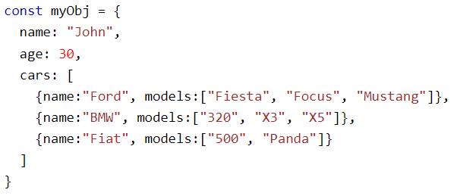
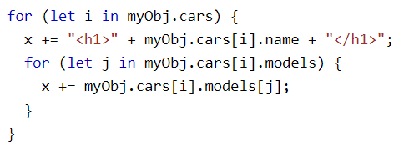
Nested Arrays and Objects
Values in objects can be arrays, and values in arrays can be objects:

Slide 60
Property Attributes
All properties have a name. In addition they also have a value.
The value is one of the property's attributes.
Other attributes are: enumerable, configurable, and writable.
These attributes define how the property can be accessed (is it readable?, is it writable?)
In JavaScript, all attributes can be read, but only the value attribute can be changed (and only if the property is writable).

Slide 61
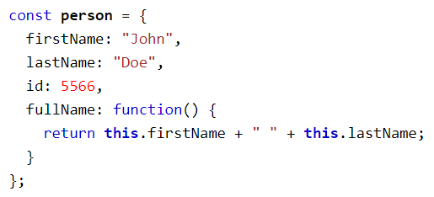


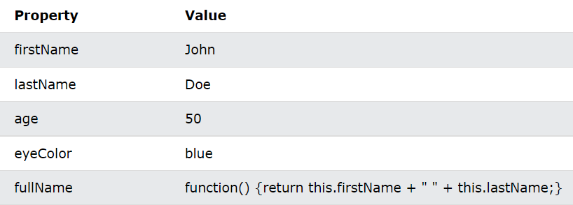
JavaScript Object Methods

Slide 62

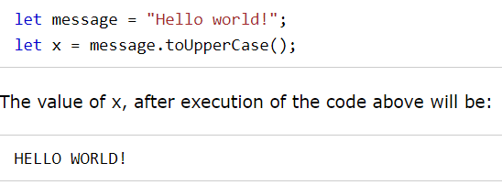
Adding a Method to an Object Using Built-In Methods
Adding a new method to an object is easy:
This example uses the toUpperCase() method of the String object, to convert a text to uppercase:

Slide 63
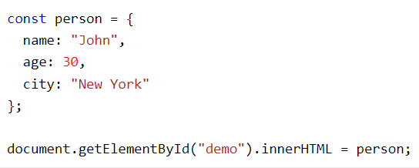

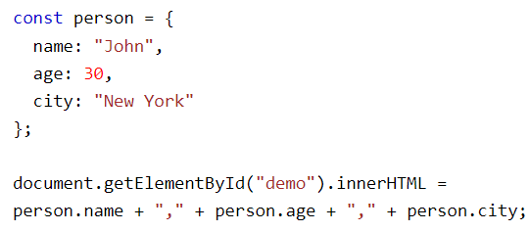
JavaScript Display Objects
How to Display JavaScript Objects?
Displaying a JavaScript object will output [object Object].
Displaying Object Properties

Slide 64
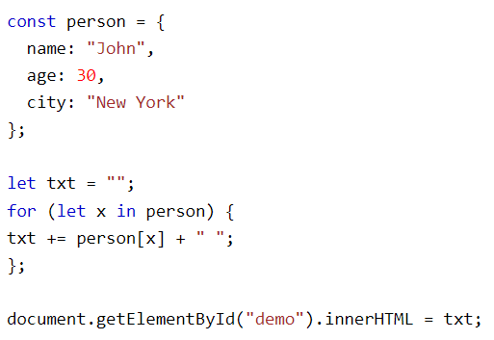
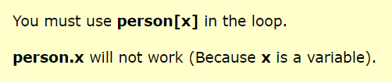
Displaying the Object in a Loop

Slide 65
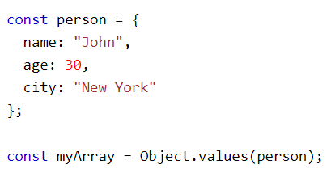

Using Object.values()
Any JavaScript object can be converted to an array using Object.values():

Slide 66
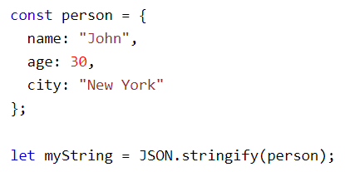
Using JSON.stringify()
Any JavaScript object can be stringified (converted to a string) with the JavaScript function JSON.stringify():
myString is now a JavaScript string, ready to be displayed:

Slide 67
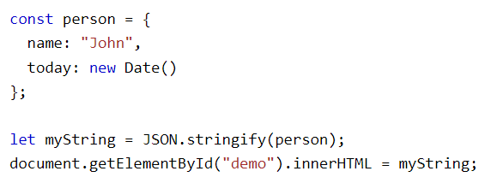
Stringify Dates
JSON.stringify converts dates into strings:

Slide 68
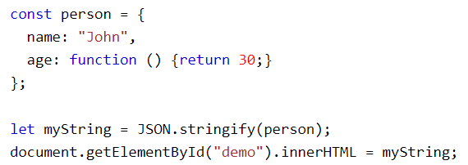

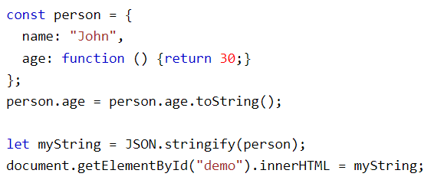

Stringify Functions
JSON.stringify will not stringify functions:
This can be "fixed" if you convert the functions into strings before stringifying.

Slide 69
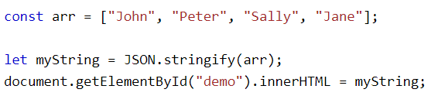

Stringify Arrays
It is also possible to stringify JavaScript arrays:

Slide 70
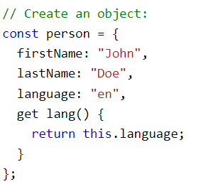
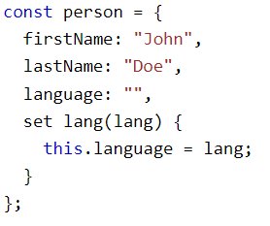

JavaScript Object Accessors (Getters and Setters)
JavaScript Getter
(The get Keyword)
JavaScript Setter
(The set Keyword)
This example uses a lang property to get the value of the language property.
This example uses a lang property to set the value of the language property.

Slide 71
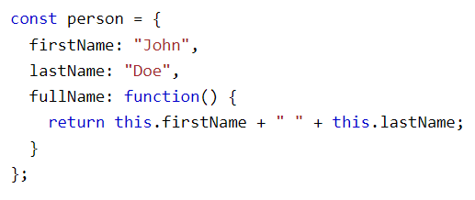
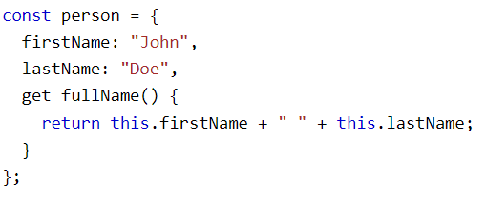


JavaScript Function or Getter?
Example 1 access fullName as a function: person.fullName().
Example 2 access fullName as a property: person.fullName.
The second example provides a simpler syntax.

Slide 72
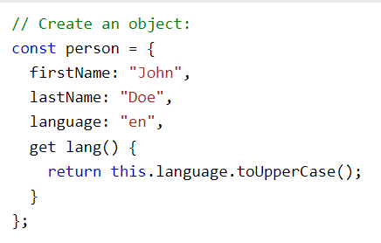
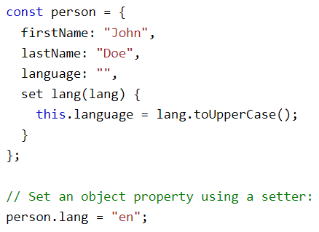
Data Quality
JavaScript can secure better data quality when using getters and setters.
Using the lang property, in this example, returns the value of the language property in upper case:
Using the lang property, in this example, stores an upper case value in the language property:

Slide 73
Why Using Getters and Setters?
It gives simpler syntax
It allows equal syntax for properties and methods
It can secure better data quality
It is useful for doing things behind-the-scenes

Slide 74
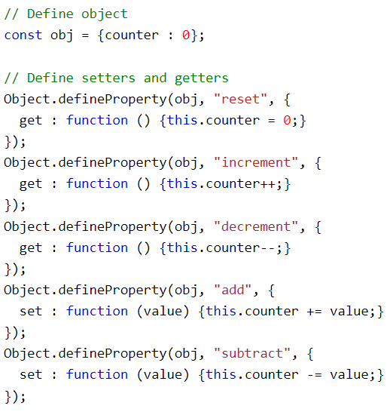

Object.defineProperty()
The Object.defineProperty() method can also be used to add Getters and Setters:

Slide 75

JavaScript Object Constructors
It is considered good practice to name constructor functions with an upper-case first letter.
In a constructor function this does not have a value. It is a substitute for the new object. The value of this will become the new object when a new object is created.

Slide 76

Object Types (Blueprints) (Classes)
The examples from the previous chapters are limited. They only create single objects.
Sometimes we need a "blueprint" for creating many objects of the same "type".
The way to create an "object type", is to use an object constructor function.
In the example above, function Person() is an object constructor function.
Objects of the same type are created by calling the constructor function with the new keyword:

Slide 77

Adding a Property to a Constructor
You cannot add a new property to an object constructor the same way you add a new property to an existing object:
To add a new property to a constructor, you must add it to the constructor function:

Slide 78



Adding a Method to a Constructor
Your constructor function can also define methods:

Slide 79


Built-in JavaScript Constructors
JavaScript has built-in constructors for native objects:

Slide 80

JavaScript Object Prototypes
All JavaScript objects inherit properties and methods from a prototype.
We also learned that you can not add a new property to an existing object constructor:
To add a new property to a constructor, you must add it to the constructor function:

Slide 81
Prototype Inheritance
Prototype Inheritance
All JavaScript objects inherit properties and methods from a prototype:
Date objects inherit from Date.prototype
Array objects inherit from Array.prototype
Person objects inherit from Person.prototype
The Object.prototype is on the top of the prototype inheritance chain:
Date objects, Array objects, and Person objects inherit from Object.prototype.

Slide 82


Using the prototype Property
The JavaScript prototype property allows you to add new properties to object constructors:
The JavaScript prototype property also allows you to add new methods to objects constructors:

Slide 83



JavaScript Iterables
Iterable objects are objects that can be iterated over with for..of.
Technically, iterables must implement the Symbol.iterator method.
You can use a for..of loop to iterate over the elements of a string:

Slide 84

JavaScript Iterators
The iterator protocol defines how to produce a sequence of values from an object.
An object becomes an iterator when it implements a next() method.
The next() method must return an object with two properties:
value (the next value)
done (true or false)

Slide 85




Home Made Iterable
A JavaScript iterable is an object that has a Symbol.iterator.
The Symbol.iterator is a function that returns a next() function.
An iterable can be iterated over with the code: for (const x of iterable) { }

Slide 86


JavaScript Sets
A JavaScript Set is a collection of unique values.
Each value can only occur once in a Set.
A Set can hold any value of any data type.

Slide 87




How to Create a Set
You can create a JavaScript Set by:
Passing an Array to new Set()
Create a new Set and use add() to add values
Create a new Set and use add() to add variables

Slide 88



The add() & foreach() methods
The forEach() method invokes a function for each Set element:
If you add equal elements, only the first will be saved:

Slide 89

The values() & keys() methods
The values() method returns an Iterator object containing all the values in a Set:
A Set has no keys.
keys() returns the same as values().
This makes Sets compatible with Maps.

Slide 90

The entries() Method
A Set has no keys.
entries() returns [value,value] pairs instead of [key,value] pairs.
This makes Sets compatible with Maps:
For a Set, typeof returns object:
For a Set, instanceof Set returns true:

Slide 91


JavaScript Maps
A Map holds key-value pairs where the keys can be any datatype.
A Map remembers the original insertion order of the keys.
A Map has a property that represents the size of the map.

Slide 92



How to Create a Map
You can create a JavaScript Map by:
Passing an Array to new Map()
Create a Map and use Map.set()

Slide 93




Get(), Size, clear(), has() methods
The get() method gets the value of a key in a Map:
The size property returns the number of elements in a Map:
The delete() method removes a Map element:
The clear() method removes all the elements from a Map:
The has() method returns true if a key exists in a Map:

Slide 94


Maps are Objects
typeof returns object:
instanceof Map returns true:

Slide 95


JavaScript Objects vs Maps

Slide 96



Foreach() & entries()
The forEach() method invokes a callback for each key/value pair in a Map:
The entries() method returns an iterator object with the [key,values] in a Map:

Slide 97



Keys() & values()
The keys() method returns an iterator object with the keys in a Map:
The values() method returns an iterator object with the values in a Map:

Slide 98

Objects as Keys
Being able to use objects as keys is an important Map feature.

Slide 99


JavaScript ES5 Object Methods
Managing Objects
Protecting Objects

Slide 100
JavaScript Classes
JavaScript Classes are templates for JavaScript Objects.

Slide 101



JavaScript Class Syntax
Use the keyword class to create a class.
Always add a method named constructor():
The example above creates a class named "Car".
The class has two initial properties: "name" and "year".

Slide 102

Using a Class the constructor method
When you have a class, you can use the class to create objects:
The example above uses the Car class to create two Car objects.
The constructor method is called automatically when a new object is created.
The constructor method is a special method:
It has to have the exact name "constructor"
It is executed automatically when a new object is created
It is used to initialize object properties
If you do not define a constructor method, JavaScript will add an empty constructor method.

Slide 103



Class Methods
Class methods are created with the same syntax as object methods.
Use the keyword class to create a class.
Always add a constructor() method.
Then add any number of methods.

Slide 104

You can send parameters to Class methods:

Slide 105

JavaScript Class Inheritance
To create a class inheritance, use the extends keyword.
A class created with a class inheritance inherits all the methods from another class:
The super() method refers to the parent class.
By calling the super() method in the constructor method, we call the parent's constructor method and gets access to the parent's properties and methods.
Inheritance is useful for code reusability: reuse properties and methods of an existing class when you create a new class.

Slide 106


Getters and Setters
Classes also allows you to use getters and setters.
It can be smart to use getters and setters for your properties, especially if you want to do something special with the value before returning them, or before you set them.
To add getters and setters in the class, use the get and set keywords.

Slide 107

Hoisting
Unlike functions, and other JavaScript declarations, class declarations are not hoisted.
That means that you must declare a class before you can use it:
Note: For other declarations, like functions, you will NOT get an error when you try to use it before it is declared, because the default behavior of JavaScript declarations are hoisting (moving the declaration to the top).

Slide 108


JavaScript Static Methods
Static class methods are defined on the class itself.
You cannot call a static method on an object, only on an object class.

Slide 109


JavaScript Arrays
However, what if you want to loop through the cars and find a specific one? And what if you had not 3 cars, but 300?
The solution is an array!
An array can hold many values under a single name, and you can access the values by referring to an index number.
An array is a special variable, which can hold more than one value:
Why Use Arrays?
If you have a list of items (a list of car names, for example), storing the cars in single variables could look like this:

Slide 110


Creating an Array
It is a common practice to declare arrays with the const keyword.
Spaces and line breaks are not important. A declaration can span multiple lines:
You can also create an array, and then provide the elements:

Slide 111

Using the JavaScript Keyword new
The following example also creates an Array, and assigns values to it:
The two examples above do exactly the same.
There is no need to use new Array().
For simplicity, readability and execution speed, use the array literal method.
You access an array element by referring to the index number:

Slide 112



Javascript arrays
Changing array element
Access to the full array
Arrays are a special type of objects. The typeof operator in JavaScript returns "object" for arrays.
But, JavaScript arrays are best described as arrays.
Arrays use numbers to access its "elements". In this example, person[0] returns John:
Objects use names to access its "members". In this example, person.firstName returns John:

Slide 113


Array Elements Can Be Objects
JavaScript variables can be objects. Arrays are special kinds of objects.
Because of this, you can have variables of different types in the same Array.
You can have objects in an Array. You can have functions in an Array. You can have arrays in an Array:
The real strength of JavaScript arrays are the built-in array properties and methods:

Slide 114



The length Property accessing first and last element

Slide 115


Looping Array Elements

Slide 116




Adding Array Elements

Slide 117


Associative Arrays
Many programming languages support arrays with named indexes.
Arrays with named indexes are called associative arrays (or hashes).
JavaScript does not support arrays with named indexes.
In JavaScript, arrays always use numbered indexes.

Slide 118

The Difference Between Arrays and Objects
In JavaScript, arrays use numbered indexes.
In JavaScript, objects use named indexes.
When to use arrays and when to use objects?
JavaScript does not support associative arrays.
You should use objects when you want the element names to be strings (text).
You should use arrays when you want the element names to be numbers.

Slide 119



How to Recognize an Array
A common question is: How do I know if a variable is an array?
The problem is that the JavaScript operator typeof returns "object":

Slide 120
JavaScript Array Methods

Slide 121




JavaScript Array Methods
The JavaScript method toString() converts an array to a string of (comma separated) array values.
The join() method also joins all array elements into a string.
It behaves just like toString(), but in addition you can specify the separator:

Slide 122


Popping and Pushing
When you work with arrays, it is easy to remove elements and add new elements.
This is what popping and pushing is:
Popping items out of an array, or pushing items into an array.
The pop() method removes the last element from an array:
It returns the value that was "popped out":
The push() method adds a new element to an array (at the end):
It returns the new array length:

Slide 123


Shifting Elements
Shifting is equivalent to popping, but working on the first element instead of the last.
The shift() method removes the first array element and "shifts" all other elements to a lower index.
It returns the value that was "shifted out":
The unshift() method adds a new element to an array (at the beginning), and "unshifts" older elements:
It returns the new array length.

Slide 124




Changing Elements
Array elements are accessed using their index number:
The length property provides an easy way to append a new element to an array:

Slide 125




Merging (Concatenating) Arrays
The concat() method creates a new array by merging (concatenating) existing arrays:
The concat() method does not change the existing arrays. It always returns a new array.
The concat() method can take any number of array arguments:

Slide 126


Splicing and Slicing Arrays
The splice() method adds new items to an array.
The slice() method slices out a piece of an array.
The first parameter (2) defines the position where new elements should be added (spliced in).
The second parameter (0) defines how many elements should be removed.
The rest of the parameters ("Lemon" , "Kiwi") define the new elements to be added.
The splice() method returns an array with the deleted items:

Slide 127





Using splice() to Remove Elements
With clever parameter setting, you can use splice() to remove elements without leaving "holes" in the array:
The slice() method slices out a piece of an array into a new array.
This example slices out a part of an array starting from array element 1 ("Orange"):

Slide 128




Slice()
The slice() method can take two arguments like slice(1, 3).
The method then selects elements from the start argument, and up to (but not including) the end argument.
If the end argument is omitted, like in the first examples, the slice() method slices out the rest of the array.

Slide 129



Automatic toString()
JavaScript automatically converts an array to a comma separated string when a primitive value is expected.
This is always the case when you try to output an array.
These two examples will produce the same result:

Slide 130




Sorting an Array
The sort() method sorts an array alphabetically:
The reverse() method reverses the elements in an array.
You can use it to sort an array in descending order:

Slide 131




Numeric Sort
By default, the sort() function sorts values as strings.
This works well for strings ("Apple" comes before "Banana").
However, if numbers are sorted as strings, "25" is bigger than "100", because "2" is bigger than "1".
Because of this, the sort() method will produce incorrect result when sorting numbers.
You can fix this by providing a compare function:
Use the same trick to sort an array descending:

Slide 132


Sorting by two criteria
Problem: Write a function that orders an array of strings, by their length in ascending order as primary criteria, and by alphabetical value in ascending order as second criteria. The comparison should be case-insensitive.
JS allows to chain two criteria by ||
The localeCompare() method returns a number indicating whether a reference string comes before, or after, or is the same as the given string in sort order. In implementations with

Slide 133

The Compare Function
The purpose of the compare function is to define an alternative sort order.
The compare function should return a negative, zero, or positive value, depending on the arguments:
When the sort() function compares two values, it sends the values to the compare function, and sorts the values according to the returned (negative, zero, positive) value.
If the result is negative a is sorted before b.
If the result is positive b is sorted before a.
If the result is 0 no changes are done with the sort order of the two values.

Slide 134

Compare function example
The compare function compares all the values in the array, two values at a time (a, b).
When comparing 40 and 100, the sort() method calls the compare function(40, 100).
The function calculates 40 - 100 (a - b), and since the result is negative (-60), the sort function will sort 40 as a value lower than 100.
Sorting an Array in Random Order

Slide 135

The Fisher Yates Method
The above example, array.sort(), is not accurate, it will favor some numbers over the others.
The most popular correct method, is called the Fisher Yates shuffle, and was introduced in data science as early as 1938!
In JavaScript the method can be translated to this:

Slide 136


Find the Highest (or Lowest) Array Value
There are no built-in functions for finding the max or min value in an array.
However, after you have sorted an array, you can use the index to obtain the highest and lowest values.
Sorting ascending and descending:

Slide 137


Using Math.max() on an Array
You can use Math.max.apply to find the highest number in an array:

Slide 138


My Min / Max JavaScript Methods
The fastest solution is to use a "home made" method.
This function loops through an array comparing each value with the highest value found:

Slide 139

Sorting Object Arrays
JavaScript arrays often contain objects:
Even if objects have properties of different data types, the sort() method can be used to sort the array.
The solution is to write a compare function to compare the property values:

Slide 140



Comparing string properties
Comparing string properties is a little more complex:

Slide 141



Array Iteration
The forEach() method calls a function (a callback function) once for each array element.
Note that the function takes 3 arguments:
The item value
The item index
The array itself
The example above uses only the value parameter. The example can be rewritten to:

Slide 142



Array map()
The map() method creates a new array by performing a function on each array element.
The map() method does not execute the function for array elements without values.
The map() method does not change the original array.
This example multiplies each array value by 2:
When a callback function uses only the value parameter, the index and array parameters can be omitted:

Slide 143


Array filter()
The filter() method creates a new array with array elements that passes a test.
This example creates a new array from elements with a value larger than 18:
In the example above, the callback function does not use the index and array parameters, so they can be omitted:

Slide 144

Array reduce()
The reduce() method runs a function on each array element to produce (reduce it to) a single value.
The reduce() method works from left-to-right in the array. See also reduceRight().
The reduce() method does not reduce the original array.
Note that the function takes 4 arguments:
The total (the initial value / previously returned value)
The item value
The item index
The array itself
The example above does not use the index and array parameters. It can be rewritten to:

Slide 145


Array every()
The every() method check if all array values pass a test.
This example check if all array values are larger than 18:
Returns boolean

Slide 146

Array some()
The some() method check if some array values pass a test.
This example check if some array values are larger than 18:
Returns boolean

Slide 147


Array indexOf()
The indexOf() method searches an array for an element value and returns its position.
Note: The first item has position 0, the second item has position 1, and so on.
Array.indexOf() returns -1 if the item is not found.
If the item is present more than once, it returns the position of the first occurrence.

Slide 148


Array lastIndexOf()
Array.lastIndexOf() is the same as Array.indexOf(), but returns the position of the last occurrence of the specified element.

Slide 149


Array find() & findindex()
The find() method returns the value of the first array element that passes a test function.
This example finds (returns the value of) the first element that is larger than 18:
The findIndex() method returns the index of the first array element that passes a test function.
This example finds the index of the first element that is larger than 18:

Slide 150



Array.from()
The Array.from() method returns an Array object from any object with a length property or any iterable object.
The Array.keys() method returns an Array Iterator object with the keys of an array.

Slide 151


Array entries()
The entries() method returns an Array Iterator object with key/value pairs:
The entries() method does not change the original array.

Slide 152


Array includes() & ForEach()
ECMAScript 2016 introduced Array.includes() to arrays. This allows us to check if an element is present in an array (including NaN, unlike indexOf).

Slide 153

Array Reverse()
The reverse() method reverses the order of the elements in an array.
The reverse() method overwrites the original array.

Slide 154



Array manipulation

Slide 155
JavaScript Function

Slide 156


JavaScript Function Definitions
JavaScript functions are defined with the function keyword.
You can use a function declaration or a function expression.
Declared functions are not executed immediately. They are "saved for later use", and will be executed later, when they are invoked (called upon).
After a function expression has been stored in a variable, the variable can be used as a function:
The function above is actually an anonymous function (a function without a name).
Functions stored in variables do not need function names. They are always invoked (called) using the variable name.

Slide 157


The Function() Constructor
As you have seen in the previous examples, JavaScript functions are defined with the function keyword.
Functions can also be defined with a built-in JavaScript function constructor called Function().
You actually don't have to use the function constructor. The example above is the same as writing:

Slide 158

Function Hoisting
Hoisting is JavaScript's default behavior of moving declarations to the top of the current scope.
Hoisting applies to variable declarations and to function declarations.
Because of this, JavaScript functions can be called before they are declared:
Functions defined using an expression are not hoisted.

Slide 159

Self-Invoking Functions
Function expressions can be made "self-invoking".
A self-invoking expression is invoked (started) automatically, without being called.
Function expressions will execute automatically if the expression is followed by ().
You cannot self-invoke a function declaration.
You have to add parentheses around the function to indicate that it is a function expression:
The function above is actually an anonymous self-invoking function (function without name).

Slide 160



Functions Can Be Used as Values
The typeof operator in JavaScript returns "function" for functions.
But, JavaScript functions can best be described as objects.

Slide 161





Functions are Objects
JavaScript functions have both properties and methods.
The arguments.length property returns the number of arguments received when the function was invoked:
The toString() method returns the function as a string:

Slide 162



Arrow Functions
Arrow functions allows a short syntax for writing function expressions.
You don't need the function keyword, the return keyword, and the curly brackets.
Arrow functions are not hoisted. They must be defined before they are used.
Using const is safer than using var, because a function expression is always constant value.
You can only omit the return keyword and the curly brackets if the function is a single statement. Because of this, it might be a good habit to always keep them:

Slide 163
Function Parameters and Arguments
Function parameters are the names listed in the function definition.
Function arguments are the real values passed to (and received by) the function.
Parameter Rules:
JavaScript function definitions do not specify data types for parameters.
JavaScript functions do not perform type checking on the passed arguments.
JavaScript functions do not check the number of arguments received.

Slide 164


Default parameters
If a function is called with missing arguments (less than declared), the missing values are set to undefined.
Sometimes this is acceptable, but sometimes it is better to assign a default value to the parameter:
ECMAScript 2015 allows default parameter values in the function declaration:

Slide 165


The Arguments Object
JavaScript functions have a built-in object called the arguments object.
The argument object contains an array of the arguments used when the function was called (invoked).
This way you can simply use a function to find (for instance) the highest value in a list of numbers:

Slide 166
JavaScript Function Invocation
The code inside a function is not executed when the function is defined.
The code inside a function is executed when the function is invoked.
It is common to use the term "call a function" instead of "invoke a function".
It is also common to say "call upon a function", "start a function", or "execute a function".

Slide 167


Invoking a Function as a Function
The function above does not belong to any object. But in JavaScript there is always a default global object.
In HTML the default global object is the HTML page itself, so the function above "belongs" to the HTML page.
In a browser the page object is the browser window. The function above automatically becomes a window function.
myFunction() and window.myFunction() is the same function:

Slide 168

What is this?
In JavaScript, the this keyword refers to an object.
Which object depends on how this is being invoked (used or called).
The this keyword refers to different objects depending on how it is used:

Slide 169

The Global Object
When a function is called without an owner object, the value of this becomes the global object.
In a web browser the global object is the browser window.
This example returns the window object as the value of this:

Slide 170


Invoking a Function as a Method
In JavaScript you can define functions as object methods.
The fullName method is a function. The function belongs to the object. myObject is the owner of the function.
The thing called this, is the object that "owns" the JavaScript code. In this case the value of this is myObject.
Test it! Change the fullName method to return the value of this:

Slide 171

Invoking a Function with a Function Constructor
If a function invocation is preceded with the new keyword, it is a constructor invocation.
It looks like you create a new function, but since JavaScript functions are objects you actually create a new object:
A constructor invocation creates a new object. The new object inherits the properties and methods from its constructor.

Slide 172

JavaScript Function call()
With the call() method, you can write a method that can be used on different objects.
In JavaScript all functions are object methods.
If a function is not a method of a JavaScript object, it is a function of the global object.
The example below creates an object with 3 properties, firstName, lastName, fullName.

Slide 173

Call() Example
The call() method is a predefined JavaScript method.
It can be used to invoke (call) a method with an owner object as an argument (parameter).
With call(), an object can use a method belonging to another object.

Slide 174


Call() method with arguments
The call() method can accept arguments:

Slide 175

JavaScript Function apply()
With the apply() method, you can write a method that can be used on different objects.
The apply() method is similar to the call() method

Slide 176

The Difference Between call() and apply()
The difference is:
The call() method takes arguments separately.
The apply() method takes arguments as an array.

Slide 177


Simulate a Max Method on Arrays
You can find the largest number (in a list of numbers) using the Math.max() method:
Since JavaScript arrays do not have a max() method, you can apply the Math.max() method instead.
The first argument (null) does not matter. It is not used in this example.
These examples will give the same result:

Slide 178

JavaScript Function bind()
With the bind() method, an object can borrow a method from another object.
The example below creates 2 objects (person and member).
The member object borrows the fullname method from the person object:

Slide 179


JavaScript Closures
JavaScript variables can belong to the local or global scope.
Global variables can be made local (private) with closures.
A function can access all variables defined inside the function, like this:
But a function can also access variables defined outside the function, like this:

Slide 180

Global variables
In the last example, a is a global variable.
In a web page, global variables belong to the page.
Global variables can be used (and changed) by all other scripts in the page.
In the first example, a is a local variable.
A local variable can only be used inside the function where it is defined. It is hidden from other functions and other scripting code.
Global and local variables with the same name are different variables. Modifying one, does not modify the other.
Variables created without a declaration keyword (var, let, or const) are always global, even if they are created inside a function.

Slide 181

JavaScript Nested Functions
All functions have access to the global scope.
In fact, in JavaScript, all functions have access to the scope "above" them.
JavaScript supports nested functions. Nested functions have access to the scope "above" them.
In this example, the inner function plus() has access to the counter variable in the parent function:

Slide 182

JavaScript Closures

Slide 183
JavaScript Closures
The variable add is assigned to the return value of a self-invoking function.
The self-invoking function only runs once. It sets the counter to zero (0), and returns a function expression.
This way add becomes a function. The "wonderful" part is that it can access the counter in the parent scope.
This is called a JavaScript closure. It makes it possible for a function to have "private" variables.
The counter is protected by the scope of the anonymous function, and can only be changed using the add function.

